Slide 1
Real-Time Communication System Powered by AI for Specially Abled
Team I'd : PNT2022TMID38653
Team Leader:
Yogeshwari S
Team members:
Aishwarya M
Hemapriya S
Sivadharshini D
Suvathini S

Slide 2
AGENDA
ABSTRACT
LITERATURE SURVEY
METHODOLOGY
ARCHITECTURE DIAGRAM
INDIAN SIGN LANGUAGE
OVERALL DESCRIPTION
USER CHARACTERISTICS
CONSTRAINTS
SCOPE
CONCLUSION

Slide 3
ABSTRACT:
One of the most precious gifts of nature to the human race is the ability to express itself byresponding to the events that occur in its environment. Every normal person sees, hears, and then reacts to the situations by expressing himself.But there are somelessn lucky ones who are deprived of this precious gift. Such people, especially deaf and mute, rely on some sort of gesture language to communicate their feelings to others. The deaf, dumb and the blind follow similar problems when it comes to the use of computers. In the era of advanced technologies, where computers, laptops and other processor-based devices are an integral part of everyday life, efforts must be made to make the disabilities in life more independent.
Our goal is to design a human computer interface system that can accurately identify the language of the deaf and dumb. With the use of image processing and artificial intelligence, many techniques and algorithms have been developed in this area. Each character speech recognition system is trained to recognize the characters and convert them into the required pattern.The proposed system aims to give speech speechless,a real-time character language is captured as a series of images, and it is processed and then converted into speech and textpattern. The proposed system aims to give speech speechless, a real-time character language is captured as a series of images, and it is processed and then converted into speech and text of the sign language is an important research problem for communication with the hearing impaired.The system does not require that the hand is perfectly aligned to the camera. The project uses the image processing system to identify, especially the English alphabetical character language used by the deaf to communicate. The system proposed to develop and build an intelligent system that uses image processing, machine learning and artificial intelligence concepts to make visual inputs of hand gestures of sign language and to create an easily recognizable form of outputs.

Slide 4
LITERATURE SURVEY
A. Two Way Communicator between Deaf and Dumb People and Normal People.
This system consists mainly of two modules,the first module is Indian Sign Language (ISL) gestures from real-time video and mapping it with human-Understandable speech. Accordingly, the second module is the natural language as Input and card with equivalent Indian Sign Language animated gestures.
B. Sign Language Recognition System to aid Deaf-dumb People
This paper presents design and implementation of real-time sign language recognition system, to gestures from the Indian sign language .

Slide 5
C. Sign Language to Text and Vice Versa Recognition using Computer Vision.
In this system edge detection algorithm is used to recognize the input character image gray scale and recognition of the edges of the hand gesture. The system is able to handle the different input records images of alphabets, words,sentences, and translates them in text and vice versa. The system is designed to translate the Marathi sign language to text.
D. Sign Language Learning based on Android forDeaf and Speech Impaired People.
This research makes an Android-based application that can directly interpret Sign language presenter bydeaf people in written language. Translation process Starts with the detection of hands with OpenCV and translation of and signals The K-NN classification. Tutorial features added in this application with the goal to trai intensively to guide the user when using the sign language.

Slide 6
METHODOLOGY:
Blob Detection:
This algorithm helps to draw rectangles around the detective part. The methods aim to detect areas in a digital image that differin properties,such as brightness or colour, compared to corresponding regions in scaled versions of the same image.A blob is a region of an image in which some properties are constant or approximately constant, all points in a blob can be viewed in a certain sense to be similar to one another.
Image preprocessing and segmentation:
The pre-processing takes place on these recorded input gestures. Then the segmentation Hands are performed to separate object and background

Slide 7
Feature Extraction:
The segmented hand image is represented with certain features. The characteristics are used for gesture recognition with the template matching algorithm that gives Optimized results.
Sign recognition. The given character gesture is recognized with the skin color recognition and the template Matching from the record.
Sign to text and Speech conversion. The recognized sign is then mapped into text and further converted into speech With TTS libraries.

Slide 8
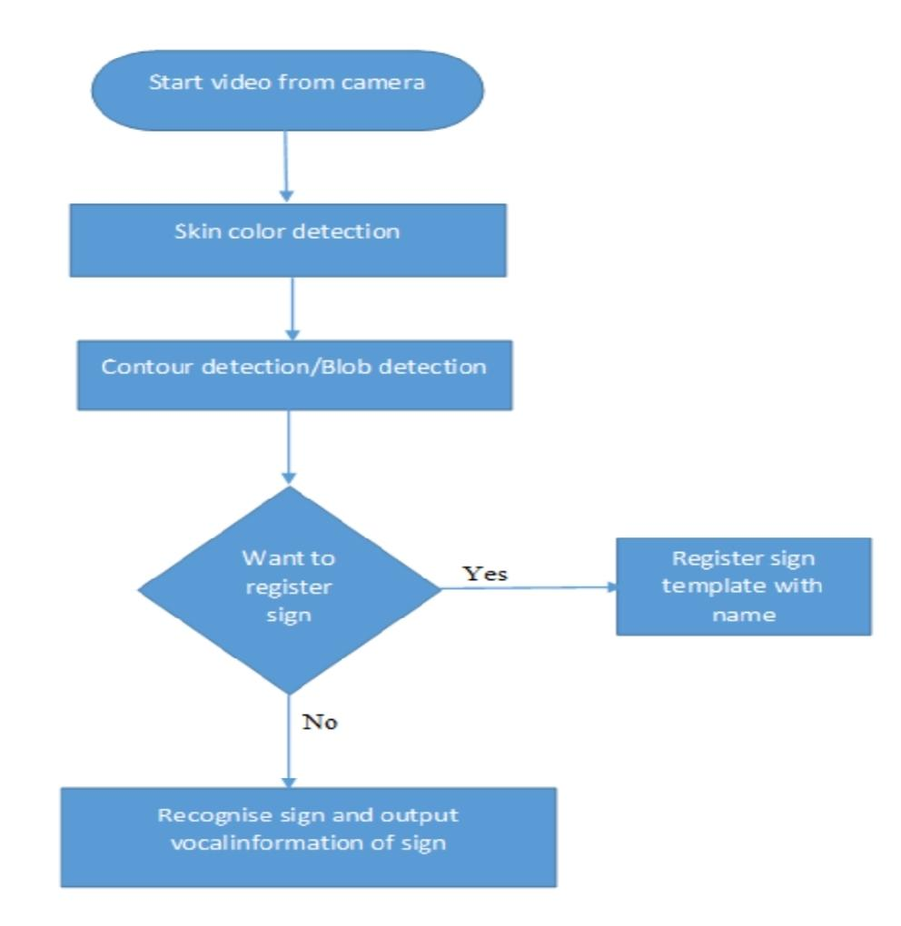
ARCHITECTURE DIAGRAM :

Slide 9
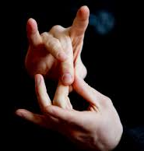
INDIAN SIGN LANGAUGE

Slide 10
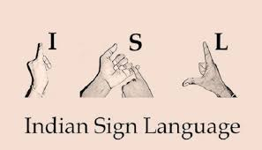
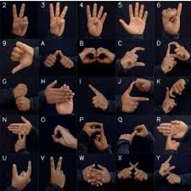

Slide 11
OVERALL DESCRIPTION
PRODUCT PERSPECTIVE:
• To implement a system for recognizing sign
language hand configurations as described which
will additionally provide the facility to each
individual to define and upload his own sign
language into the system since every country or
even regional group uses its own set of signs.
• To develop a tool which will help deaf people in
communication. To develop a Sign language, can be
translated into text or sound based on images,
videos. Signs can be converted to Speech so that
there is a two - way communication.

Slide 12
PRODUCT FUNCTION:
It’s a Desktop application. • User will start video from camera.
• User will be able to register different signs for further recognition using camera.
• When user will start recognition activity and give various hand gestures in front of camera, sign will be detected and speech will be produced to announce detected sign.

Slide 13
USER CHARACTERISTICS
1. Systems interface will allow user to start video from
camera.
2. User will do different hand gestures in front of camera.
3. User will able to see video, recognized sign on GUI.
4. User will get output in the form of sound which is
converted from Speech of recognized sign.

Slide 14
CONSTRAINTS
Accuracy of system may vary depending upon light intensity changes.
Also accuracy depends upon distance between camera and object.

Slide 15
SCOPE
1.roposed systems scope is related with education of dumb peoples. Dumb people faces many problems when normal person could not understand their language. They were facing communication gap With normal peoples.
2.For communication between deaf person and a
second person, a mediator is required to translate
sign language of deaf person. But a mediator is
required to know the sign language used by deaf
person. But this is not always possible since there
are multiple sign languages for multiple languages.
So to understand all sign languages, Hand gestures of deaf peoples by normal peoples this system is proposed. System gives output in the form of sound.

Slide 16
CONCLUSION:
The proposed communication system between Deaf and Dumb people and ordinary people are aiming for it when bridging the communication gap between two societies. Several work is done earlier in this area, but this paper adds in complete two -sided communication in an efficient manner because the system is implemented as one Handy mobileapplication.So,itreallyservesitsneedsinallaspects. The above strategies prove to be efficient In terms of time and accuracy. Further improvements can be done in the implementation of the communicator with other sign language such as American Sign Language, Accent recognition for different accents throughout Globe, recognition of emotions in sign language and language Translation.

Slide 17


